Slide 1
Advance Digital Radiovisography in Dentistry
Vestige Software Technologies &
Edlen Imaging LLC, USA
Miss. Pooja Nanadagopal
Advance Digital Radiovisography in Dentistry Vestige Software Technologies Ver 3.0

Slide 2
INDEX
Abstract
Literature Survey
Problem Statement
Development Environment
System Architecture
Data Flow Diagram
ER Diagram
Use Case Diagram
Data Flow
Module Description
Testing Methodologies
Conclusion
Advance Digital Radiovisography in Dentistry Vestige Software Technologies Ver 3.0

Slide 3
ABSTRACT
RadioVisioGraphy (RVG) as the latest imaging technique in dentistry with the minimal radiation exposure of the patient and numerous possibilities to process the images has many advantages over classic radiography.
The RadioVisioGraphy (RVG) imaging system commonly used in dentistry to take intraoral radiographs features the latest innovations in digital radiography, delivering the highest image resolution.
The results are faster and better with no loss in image quality.
The software is designed in such a way to make use of this images captured by the RadioVisoGraphy in a reliable, affordable and lesser time frame by applying the need and the thoughts of dentist and the patients.
Advance Digital Radiovisography in Dentistry Vestige Software Technologies Ver 3.0

Slide 4
Literature Survey
Comparison of B/W Film Based and Digital Radiography.
Film Based Imaging | Digital Imaging
Lower initial investment | Higher initial investment
More time to final image viewing (5-7 minutes) | Rapid image viewing (within 1 minute)
Manual Image Processing | Automated Image Processing
Lower image quality | Excellent image quality
Labor-intensive Needed | Completely digitized setup
Lower patient throughput | High patient throughput
Higher risk of overexposure | Lower risk of overexposure
Less efficient | More efficient
Images cannot be altered | Images can be altered based on the needs.
Advance Digital Radiovisography in Dentistry Vestige Software Technologies Ver 3.0

Slide 5
INDICATIONS AND USE
Literature Survey
In the Field of Dentistry
Detection of Tumors
Detection of hard Tissues
For Implants analysis
Detection of Carries and Periodontal Diseases
Advance Digital Radiovisography in Dentistry Vestige Software Technologies Ver 3.0

Slide 6
PROBLEM STATEMENT
The increasing demand for radiology services and the limited resources of radiologists have led to a long waiting time for radiology results. Increased radiology turnaround time will cause radiology services become delay, which can affect patients complaint. To overcome the problem of delay problem, availability, and affordability for diagnostic radiology services, there needs to be a rapid change in the model of health care delivery in radiology services.
Advance Digital Radiovisography in Dentistry Vestige Software Technologies Ver 3.0

Slide 7
DEVELOPMENT ENVIRONMENT
For Developing the Software we use
VB.Net Technology
SQL Server
S11684S11685APL - Source From the RVG Manufacturer
SDK - CMOS_USB.dll, DynamicDataDisplay.dll
Functional Library Files for S11684S11685
Advance Digital Radiovisography in Dentistry Vestige Software Technologies Ver 3.0

Slide 8
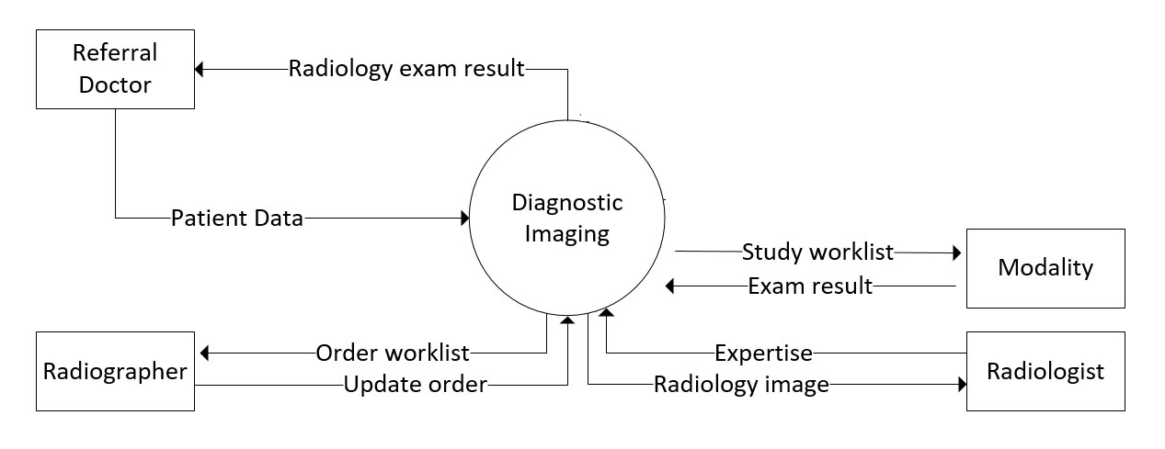
SYSTEM ARCHITECTURE

Slide 9
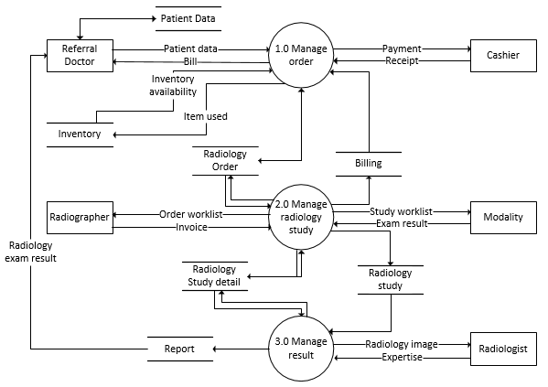
SYSTEM DESIGN - DFD

Slide 10
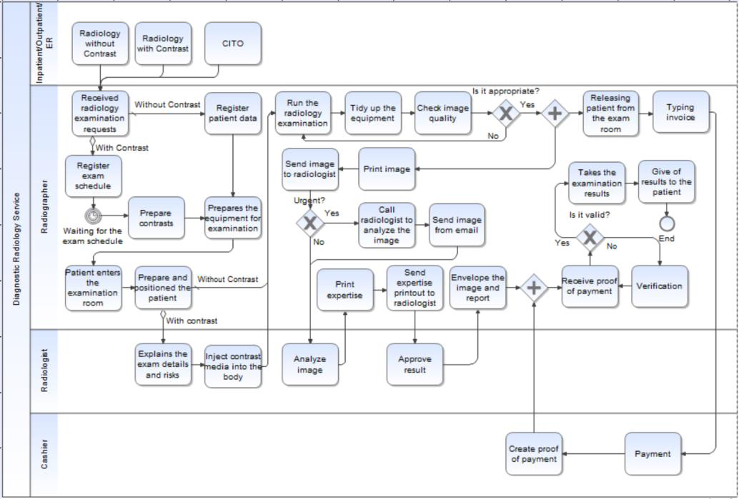
SYSTEM DESIGN – ER Diagram

Slide 11
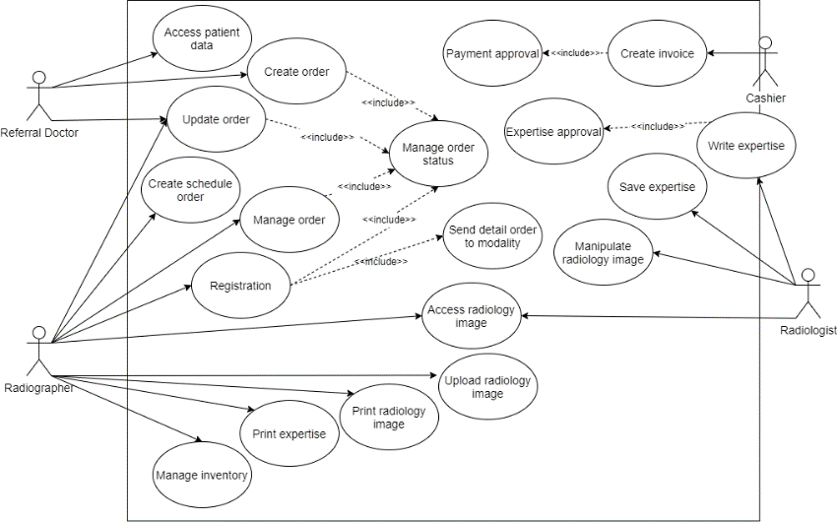
SYSTEM DESIGN – Use Case

Slide 12
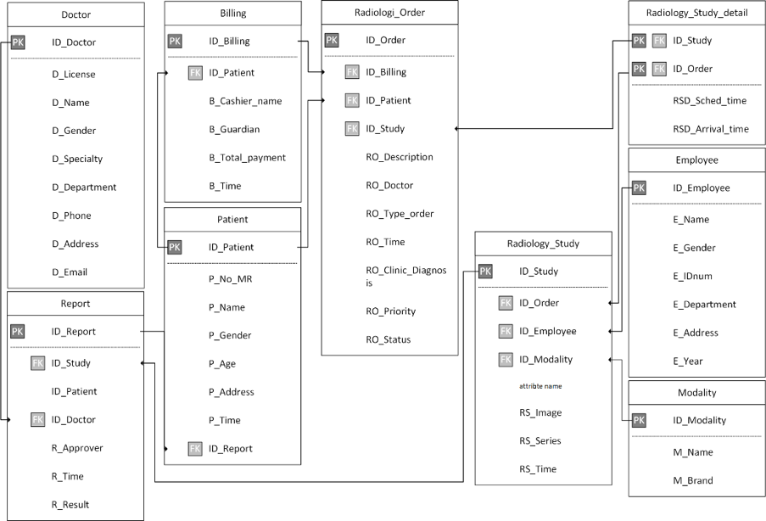
SYSTEM DESIGN – Data Flow

Slide 13
MODULE DESCRIPTION
LynxVision 5.0 Consist of 4 Modules.
Intra Oral Camera
Intra Oral Sensor
Intra Oral Scanner (PP Plates)
Orthopantograph (OPG)
This single software can be used to capture and process the images from 4 Different types of Dental Radiology Services
* Devices which is not connected to the software always will show a Red Color Mark on the software screen.

Slide 14
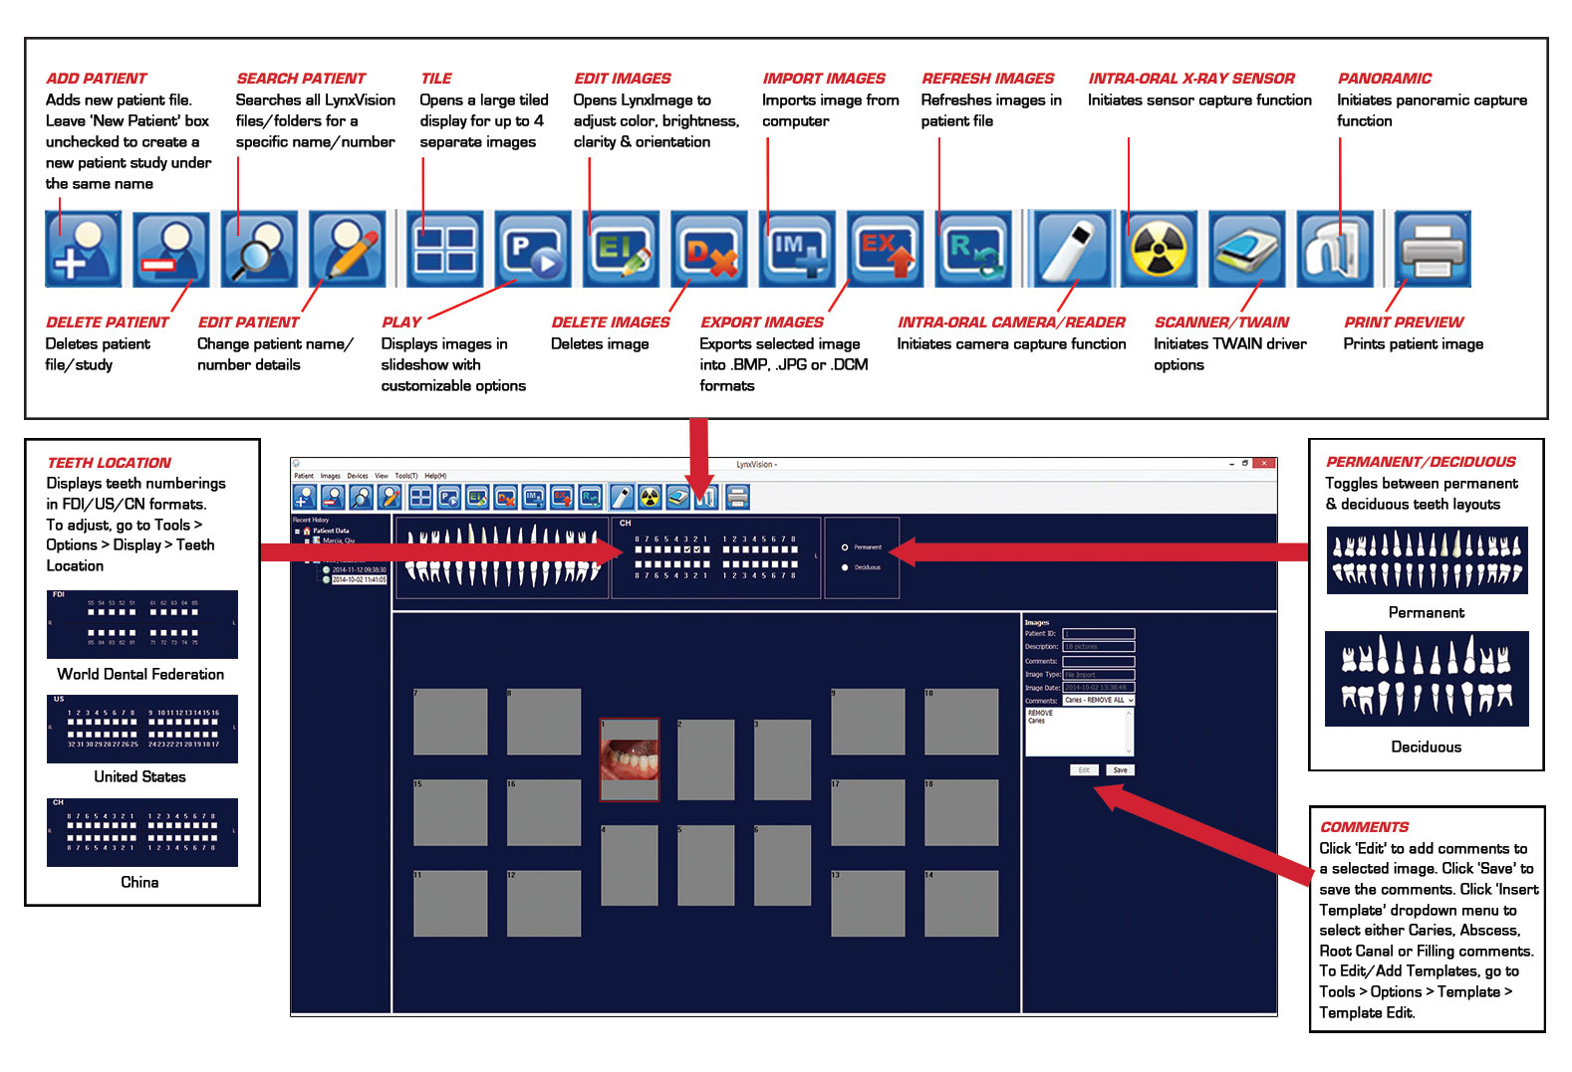
MODULE DESCRIPTION

Slide 15
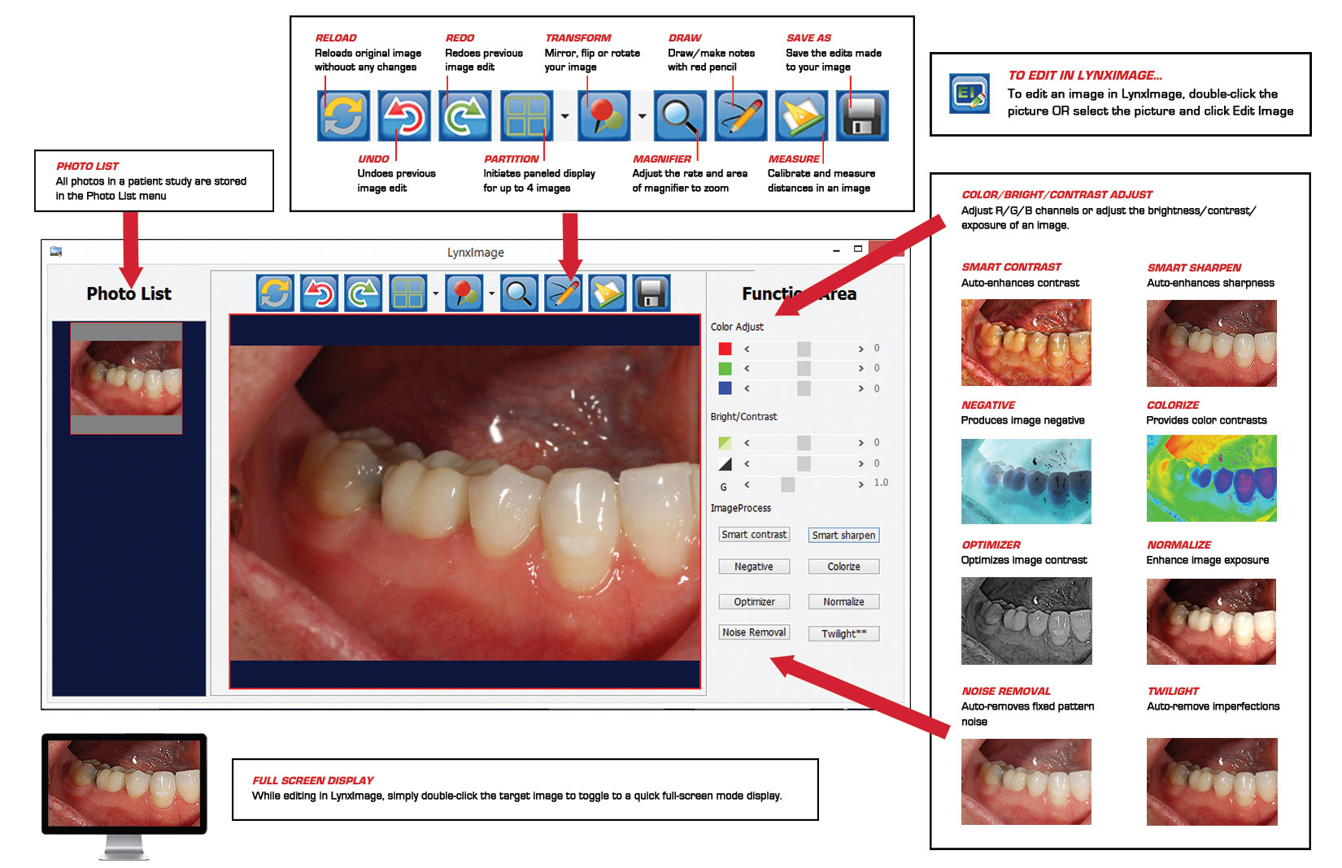
MODULE DESCRIPTION

Slide 16
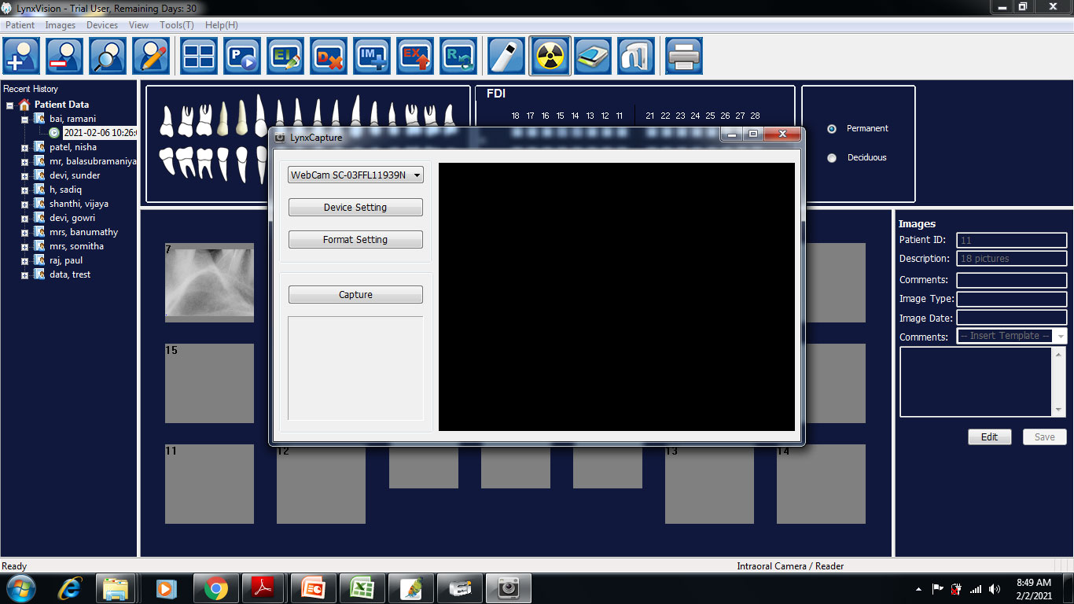
MODULE DESCRIPTION

Slide 17
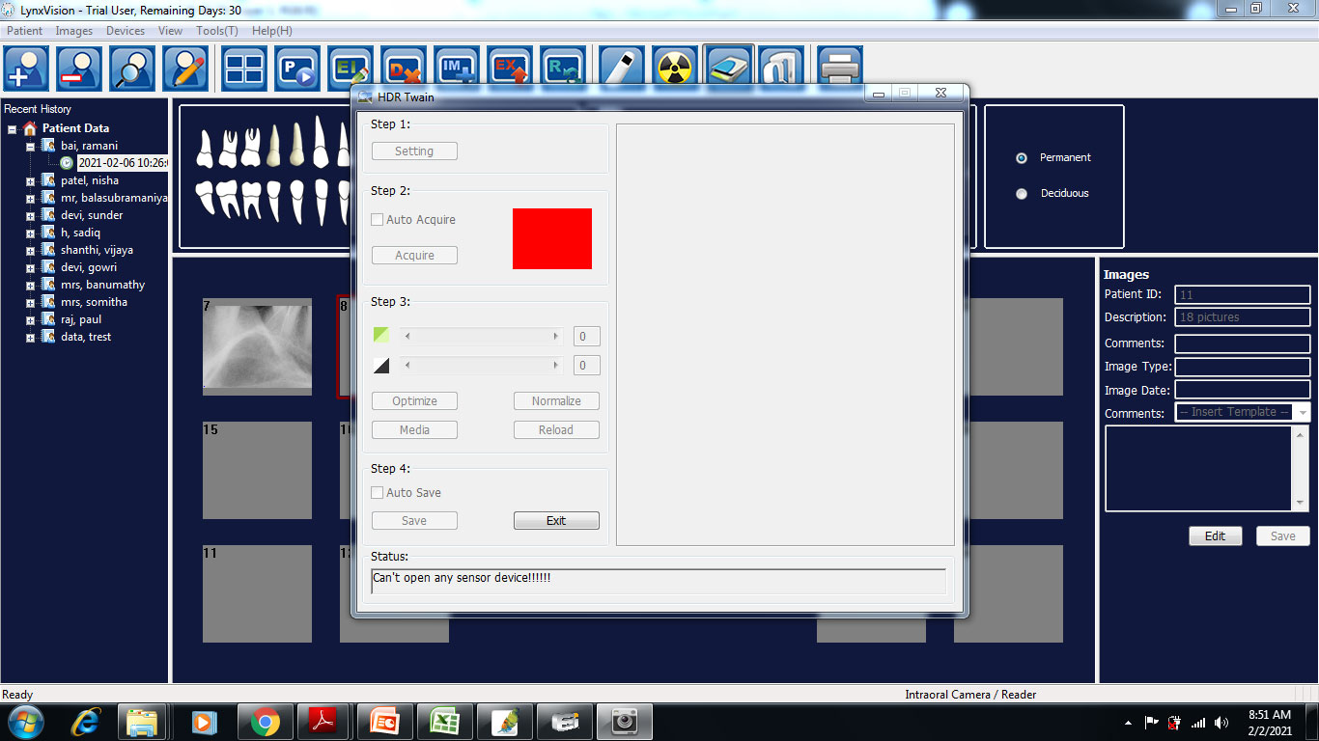
MODULE DESCRIPTION

Slide 18
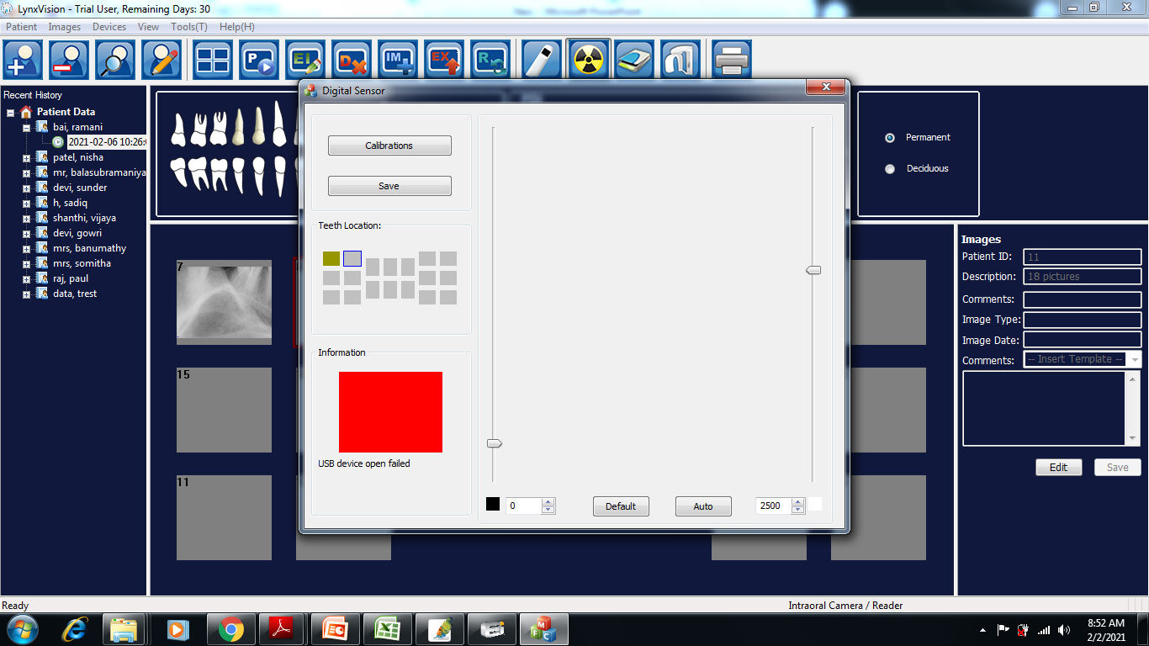
MODULE DESCRIPTION

Slide 19
TESTING METHODOLOGIES
Software testing methodologies are the various strategies or approaches used to test an application to ensure it behaves and looks as expected.
Functional Testing
Unit testing
Integration testing
System testing
Acceptance testing
Non – Functional Testing
Performance testing
Security testing
Usability testing
Compatibility testing

Slide 20
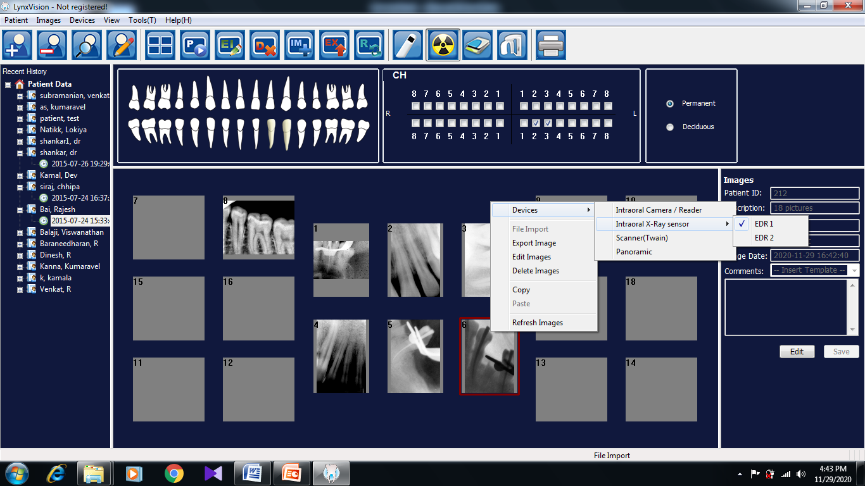
SAMPLE SCREENS
Advance Digital Radiovisography in Dentistry Vestige Software Technologies Ver 3.0

Slide 21
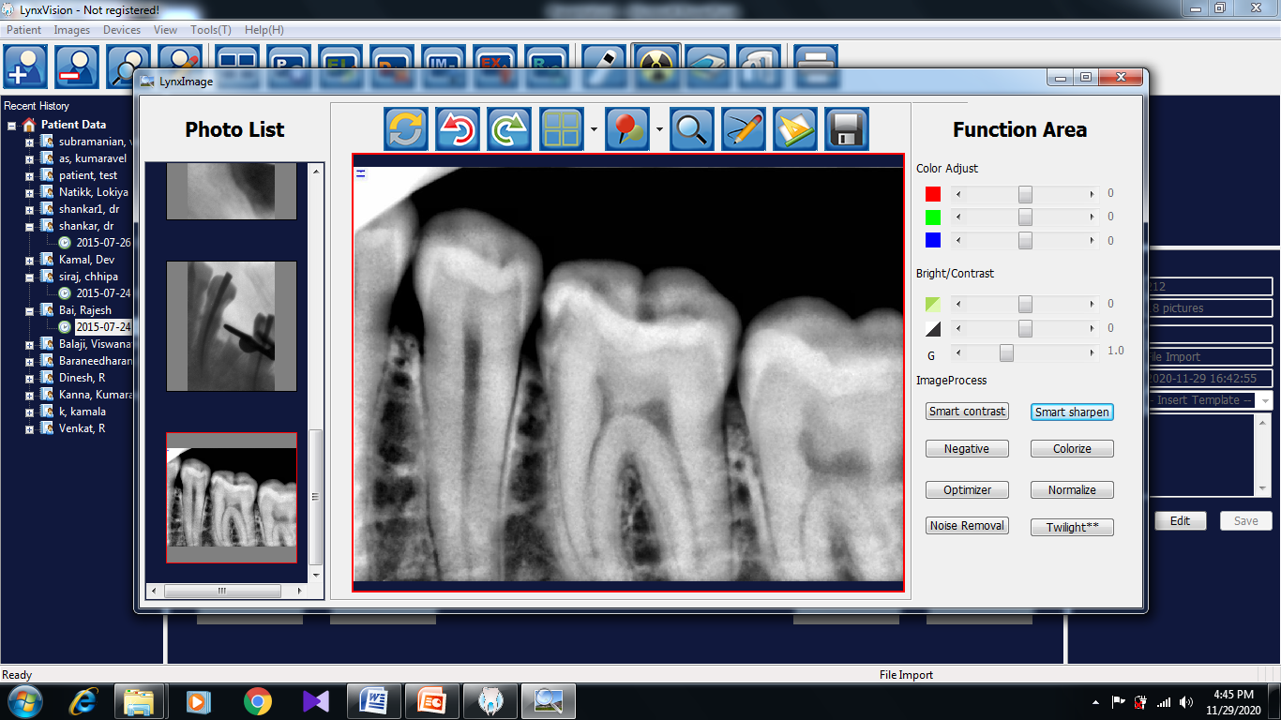
SAMPLE SCREENS
Advance Digital Radiovisography in Dentistry Vestige Software Technologies Ver 3.0

Slide 22
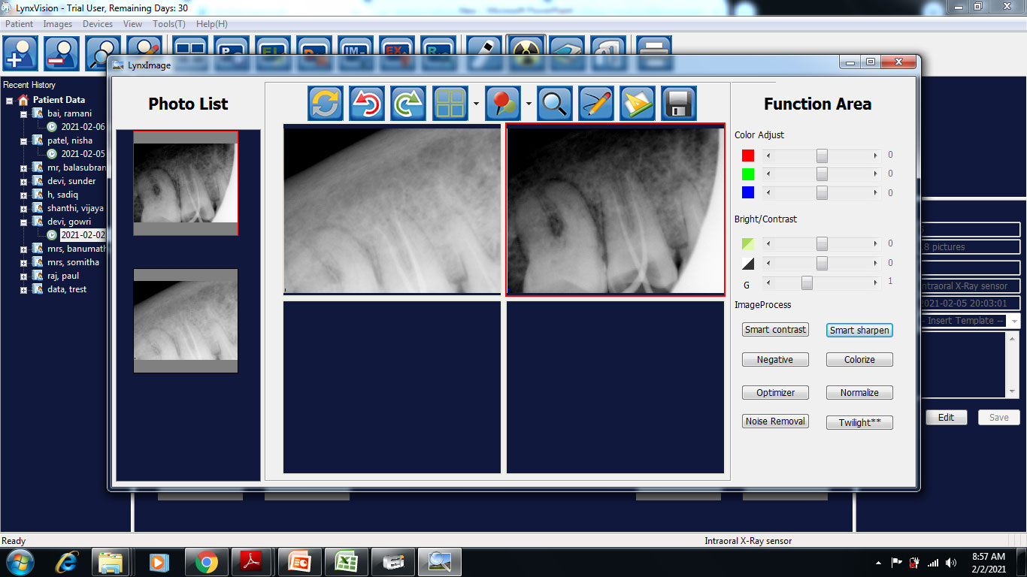
SAMPLE SCREENS
Advance Digital Radiovisography in Dentistry Vestige Software Technologies Ver 3.0

Slide 23
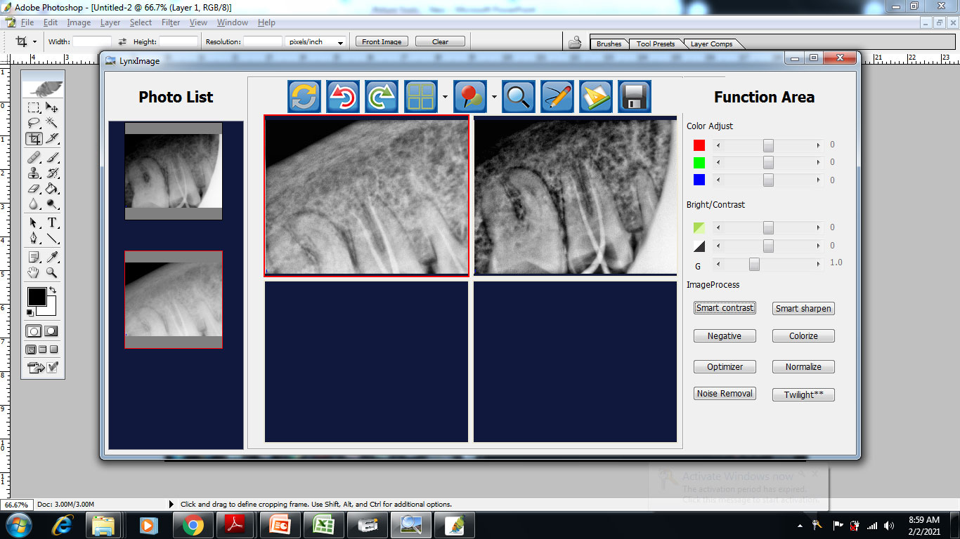
SAMPLE SCREENS
Advance Digital Radiovisography in Dentistry Vestige Software Technologies Ver 3.0

Slide 24
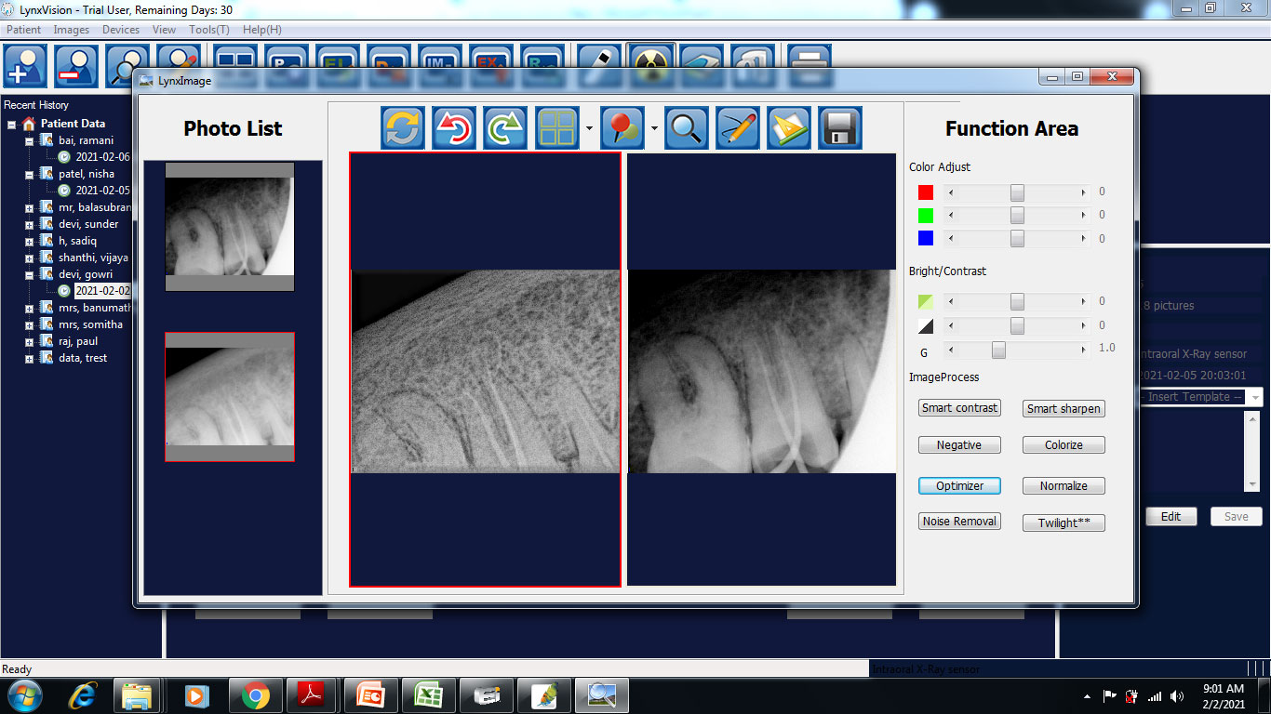
SAMPLE SCREENS
Advance Digital Radiovisography in Dentistry Vestige Software Technologies Ver 3.0

Slide 25
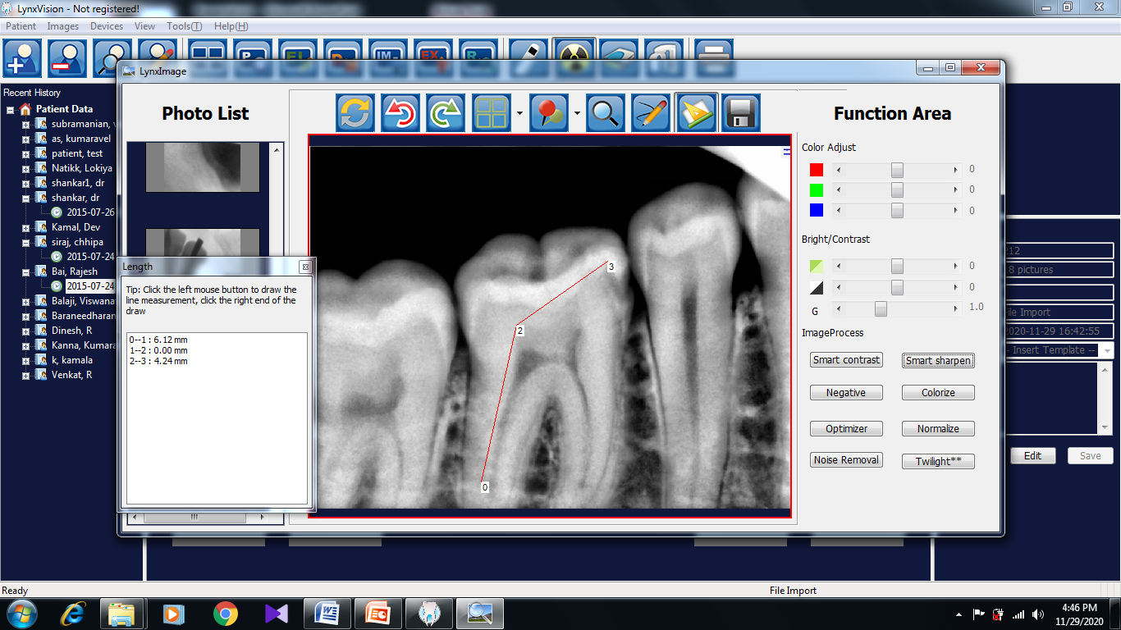
SAMPLE SCREENS
Advance Digital Radiovisography in Dentistry Vestige Software Technologies Ver 3.0

Slide 26
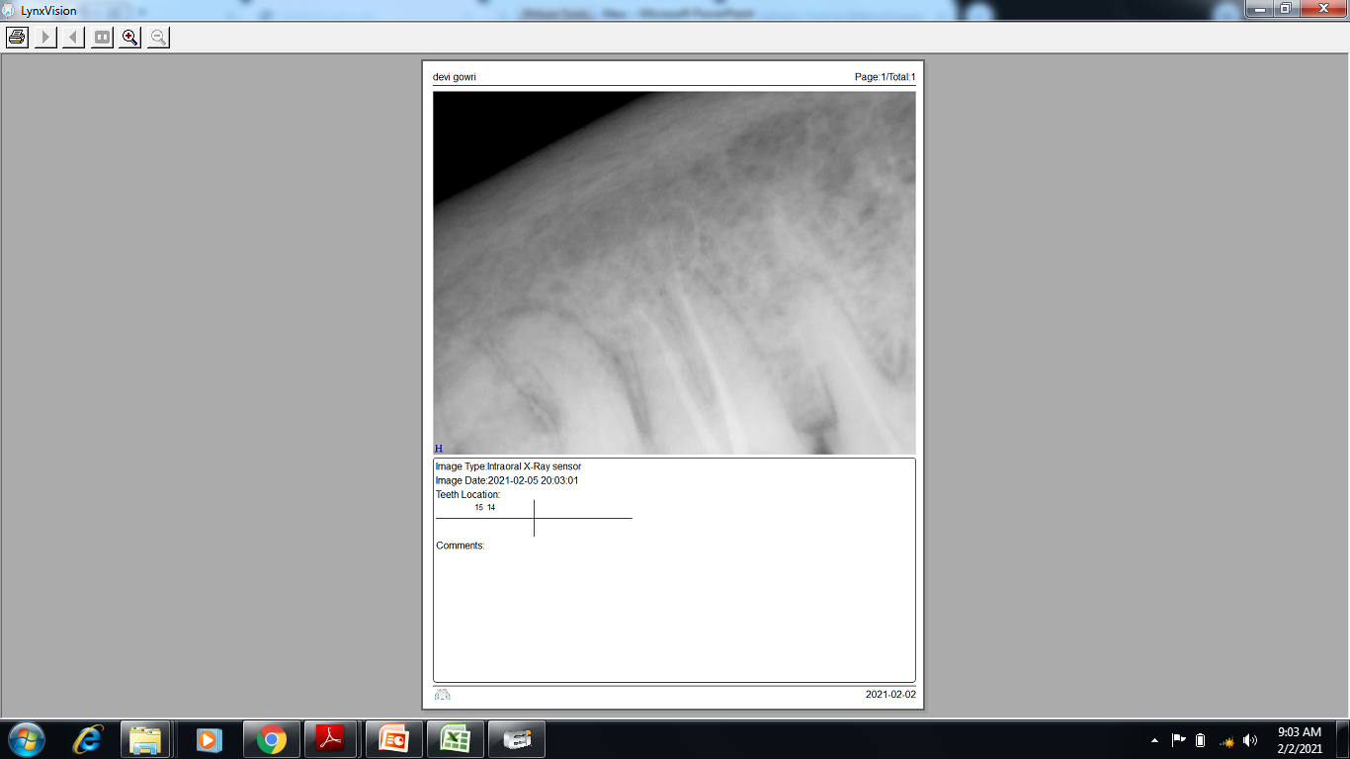
SAMPLE SCREENS
Advance Digital Radiovisography in Dentistry Vestige Software Technologies Ver 3.0

Slide 27
CONCLUSION
By applying RVG technique the time for diagnostic procedure is much shorter in comparison with traditional dental radiography enabling archiving and follow-up the presented case in the course of time.
Reliable, Scalable, Quality Images
Advancement to 3D Technology from 2D Technology
Advance Digital Radiovisography in Dentistry Vestige Software Technologies Ver 3.0

